Slide 1
Welcome to Ms. Nack’s Class!
2018-2019 School Year

Slide 2
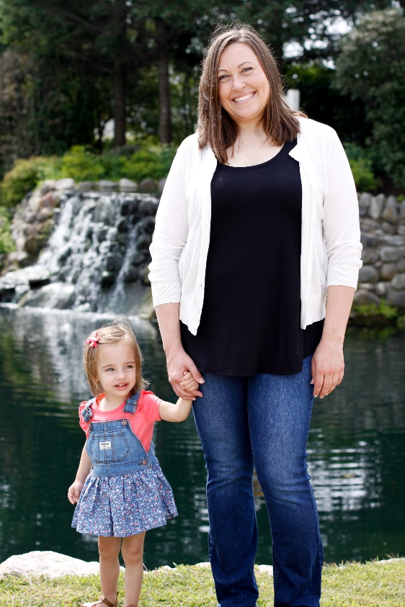
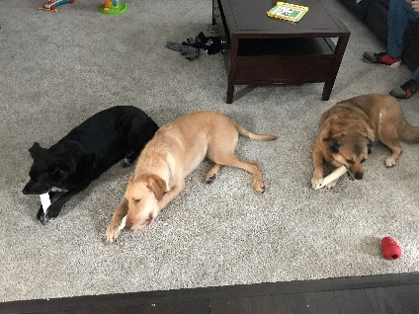
Ms. Carrie Nack

Slide 3
What will we learn in Third Grade?

Slide 4
Topics we will cover in Math
Eureka Math
Multiplication and division
Fractions
Time
Geometry
Rounding
Measurement
How can you help?
Work on multiplication facts
Ask math questions during everyday activities
Utilize math game websites
Notes:
Mad minutes

Slide 5
Reading and Language Arts
Making predictions
Context clues
Summarizing
Making inferences
Story elements
Genres of writing
Parts of speech
Foundations
Fluency
Sight Words
How can you help?
Ask your child questions about the books they read at home
Read together when possible
Encourage students to write stories at home or keep a journal
Review Sight Words
Utilize Websites
Notes:
Writing fluency

Slide 6
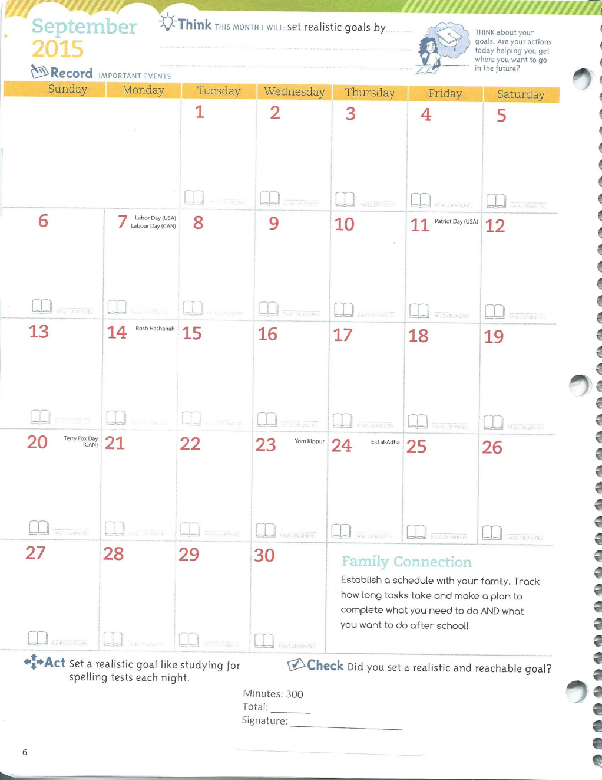
Reading Log
Please help keep track of monthly reading minutes.
At the end of the month, write down the total number of minutes and sign.

Slide 7
Science
How can you help?
Make sure you check assignment notebook
Help your child make connections between science and literature
Mystery Science
Physical Science
Earth Science
Life Science
Notes:
Mrs. Silverblatt

Slide 8
Social Studies
History
Geography
Civics
Economics
Inventors
How can you help?
Review vocabulary
Check assignment notebook daily
Check your child’s daily/weekly folder

Slide 9
STUDENT ASSISTANCE
3rd Grade
Ms. Jean Bowen
We are part of the cooperative team of 3rd grade teachers providing services for students identified as in need of :
*educational intervention services
(RTI - Response to Intervention)
*IEP (Individual Education Plan)
services

Slide 10
Other Information
We will be going on field trips this year – dates and locations TBD
Please check your child’s daily/weekly folders and remove papers that are sent home.
Please check the Virtual Backpack every week.
Challenge Math/Noetic Math

Slide 11
Specials
Headphones
Gym Shoes
PE: Mrs. Miller
Computers: Mrs. Silverblatt
Music: Mrs. Schiller
Library: Mrs. DeGeorge
Art: Mrs. Weiskopf

Slide 12
Classroom Behavior
PBIS, STARbucks – Prizes and Passes
Home/School Agreement
Attendance
Goals

Slide 13
Homework
Assignment Notebook
Website
Monthly Homework Party

Slide 14
Snack
Healthy Snacks
Nut Free
Folders
Take Home
Friday Folder

Slide 15
Tests
MAP
AIMES Web
Fountas and Pinnell
Sight Words
Needs
Stop by the PBIS Table on your way out

Slide 16
Communication
Newsletter – emailed every Friday/Saturday
Email – Carrienack@bighollow.us
Website – http://msnack.weebly.com/
Phone – 847-740-1490 ext. 4301
Seesaw
Friday Folder

Slide 17
Please let me know if there is anything I can do to help you or your child!
Thank you for coming!!
Conferences:
https://signupahead.com/signup/3cc3njf4

Slide 18
Thank you for coming!
It’s going to be a great year!

